Slide 1

SALES DATA ANALYSIS & DASHBOARD
RAHMA RABEE

Slide 2

Introduction
This project focuses on analyzing a sales dataset and transforming it into meaningful insights that support better decision-making.
First, I explored the dataset to understand its structure, the relationships between tables, and the purpose of each column. This helped me identify which data is important and which can be removed.
The dataset represents a complete sales system including customers, cities, employees, products, and transactions, which allows for analyzing sales performance from different perspectives.

Slide 3
Data Cleaning
After fully understanding the dataset, I moved to the data cleaning phase, which is one of the most important steps in any data analysis project.
The main objective here was to ensure data quality by removing redundancy, handling inconsistencies, and keeping only the most relevant features for analysis.
I followed a structured approach, cleaning each table individually based on its role in the overall system.

Slide 4
Data Cleaning
City Table
Customer Table
Database Extraction
  Removed: Country, Location, Sales Territory (redundant data)
  Kept: City, State (important for analysis)
  Removed duplicated ID column
  Removed unnecessary columns like Category
  Removed Valid From & Valid To (non-informative values)
  Removed duplicated month-related columns
  Kept main Date column for time analysis

Slide 5
Data Cleaning
Employee Table
Stock Item Table
Sales / Orders Table
  Kept: Employee Key, Employee Name, Is Salesperson
  Kept: Unit Price, Tax Rate
  Removed duplicated or irrelevant columns
  Removed duplicate rows
  Converted values to numeric format (prices, quantities)

Slide 6
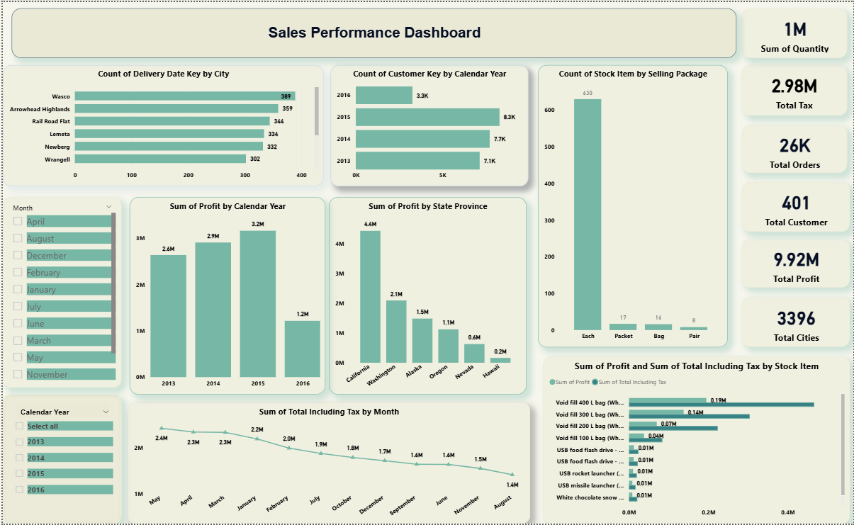
Dashboard &
Dashboard & Visualization

Slide 7
THANK YOU!

